Slide 1
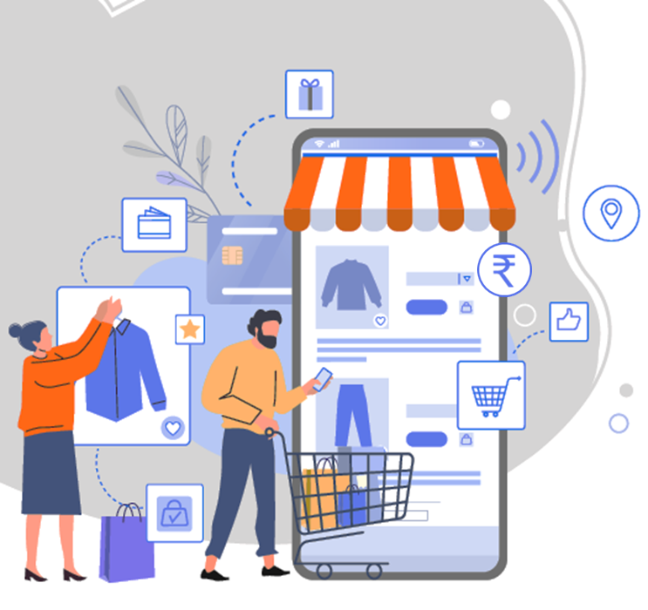
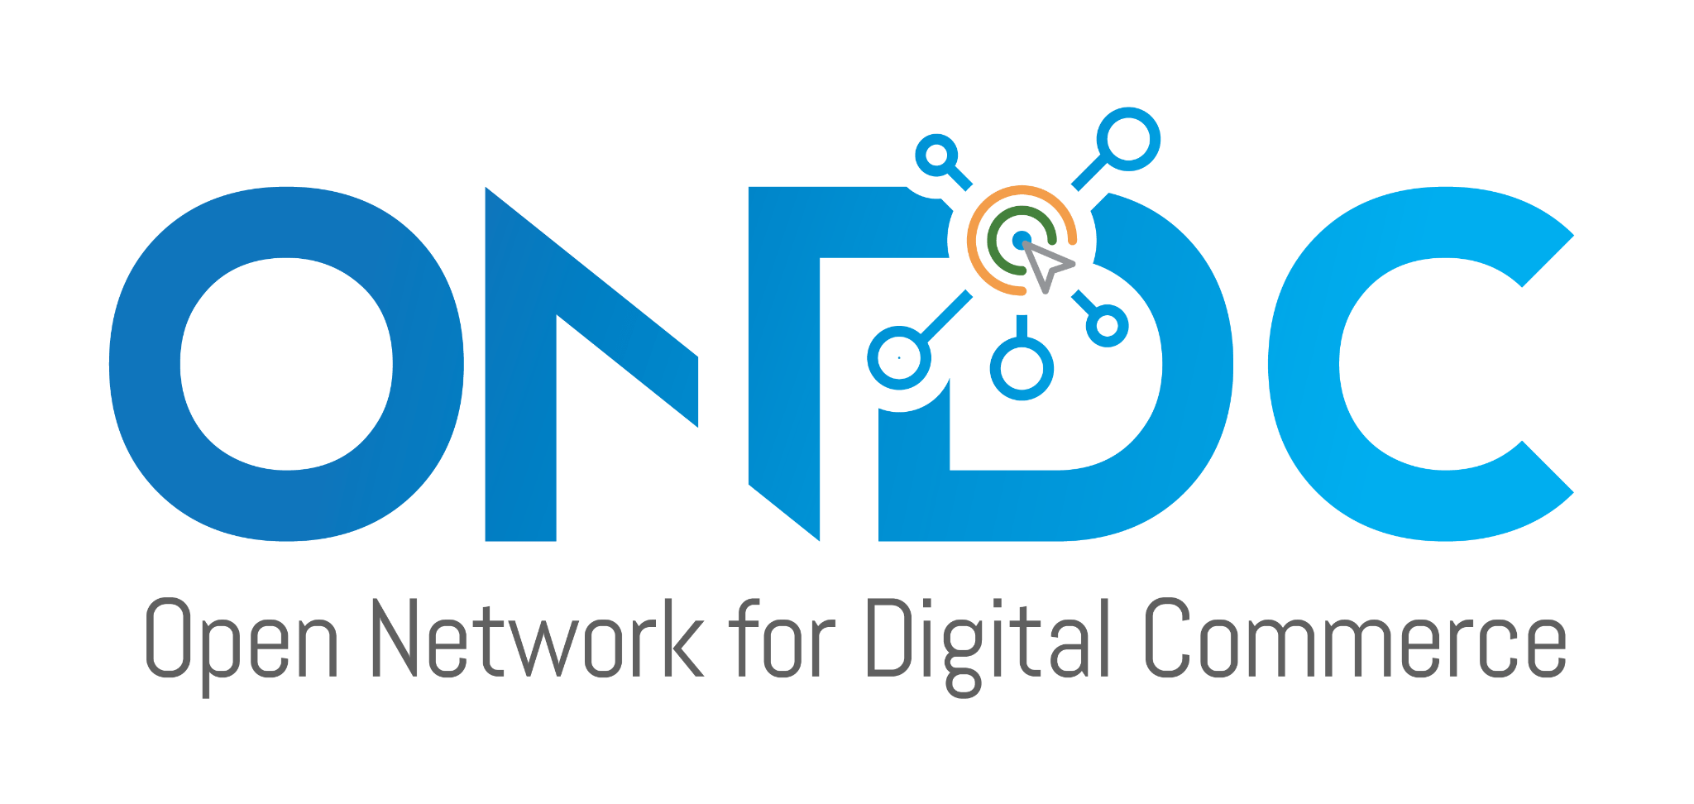
Become part of India’s
Digital Commerce Revolution
Briefing Presentation

Slide 2
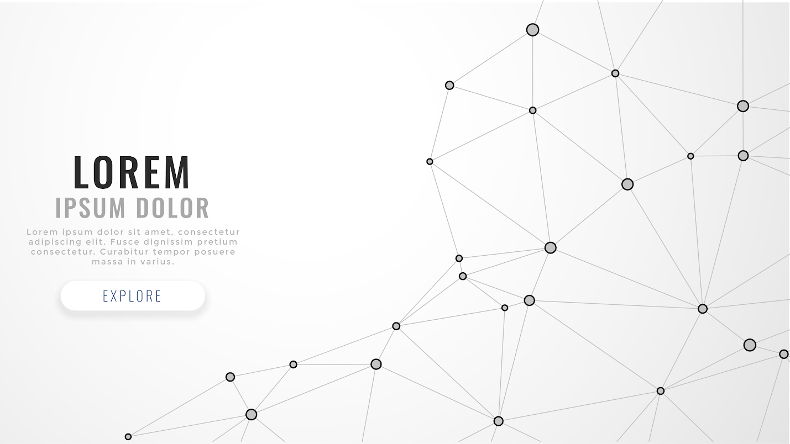
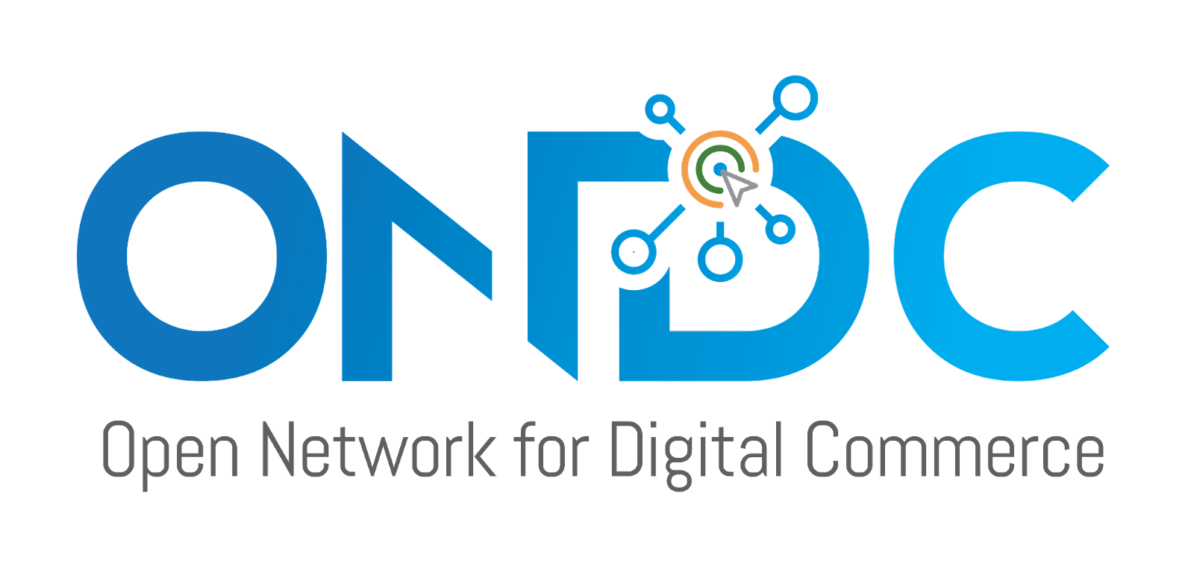
AGENDA
Time | Session | Lead
2:30 - 2:35 PM | Inaugural Session · Directorate of Industries and Commerce | Directorate of Industries and Commerce, GoK
2:35 - 2:40 PM | Inaugural Session · Public Sector Restructuring and Internal Audit Board (RIAB) | RIAB, GoK
2:40 - 2:55 PM | Introduction to ONDC Concept · Demo of an ONDC Transaction | ONDC
2:55 - 3:05 PM | Q/A Session | ONDC
3:05 - 3:30 PM | Roles of participants on ONDC network and introduction to Network Participants (NPs) · Short presentation/introduction by NPs | ONDC and NPs
3:30- 3: 40 PM | Closing remarks | GoK and ONDC

Slide 3
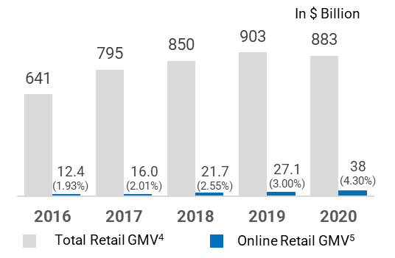
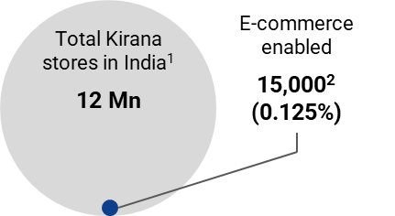
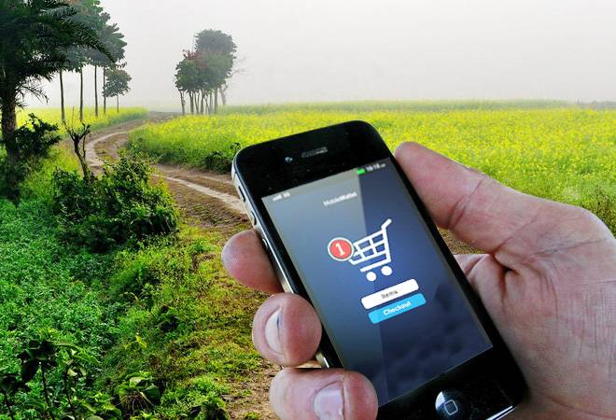
ONDC’s goal is to dramatically step change eCommerce penetration
Limited Reach
Significant part of retail sector is not digitally enabled
E-retail penetration is only 4.3% in India; well below China (25%), South Korea (26%), and the UK (23%)
Limited reach to smaller towns and rural area
Sources:
1. Financial Express Article 2. Economic Times Article 3. UNCTAD Report 4. MapsofIndia Business Article 5. Livemint coverage on online retail (July’21)

Slide 4
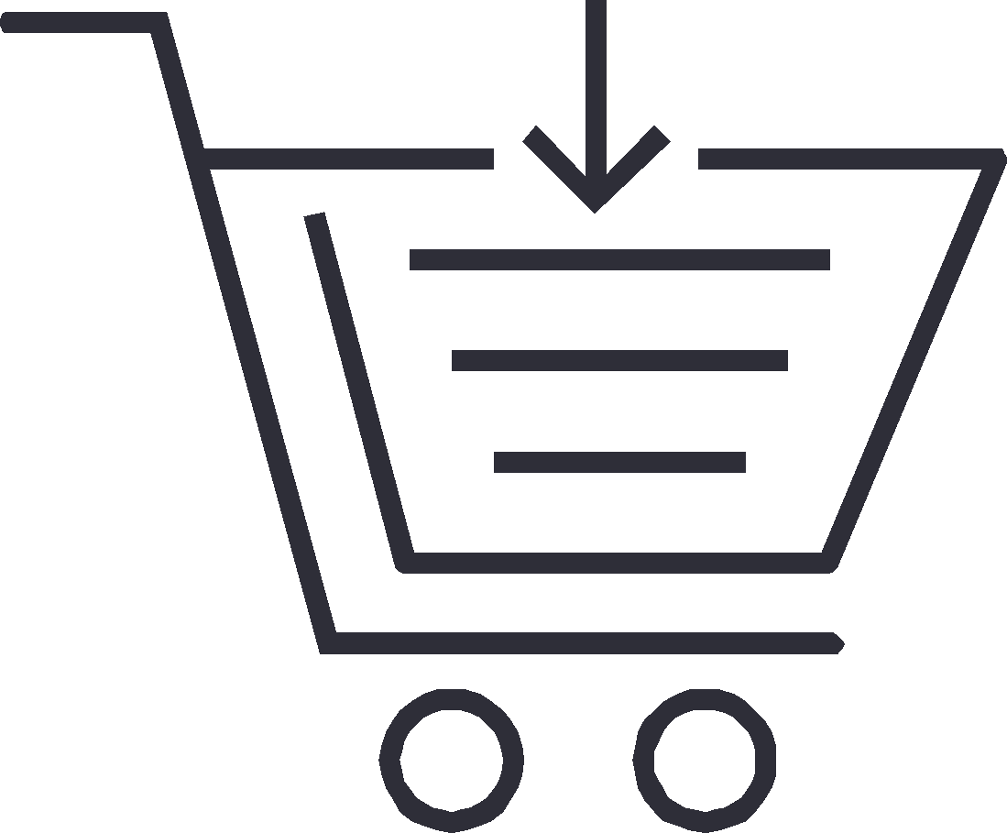
We are working towards enabling population scale inclusion of merchants and buyers
Increasing the Gross Merchandise Value (GMV) of digital transactions from ~INR 4.5 lakh crore annually, to more than INR 7.5 lakh crore
Expanding the coverage of retailers using digital commerce from ~15,000 out of 1.2 crores retailers today, to more than 20 lakhs
Expanding the share of Indians using eCommerce to buy online from ~9 crore users currently, to more than 25 Crores
Amplifying the geographic coverage of eCommerce to cover 75% of the total PIN Codes
…in the next 5 years

Slide 5
ONDC has been designed to solve key factors across the value chain holding back participation
Choices for sellers to be online
Ability for retailers and merchants to set their own terms and conditions
Discoverability for buyers and sellers beyond large eCommerce platforms
Opportunities for small eCommerce players - barriers to stitching the value chain

Slide 6
The design revolves around 2 interrelated principles
c
UNBUNDLING
of customer & seller acquisition to reduce Go-to-market efforts
INTEROPERABILITY
between platforms/ applications for greater market access

Slide 7
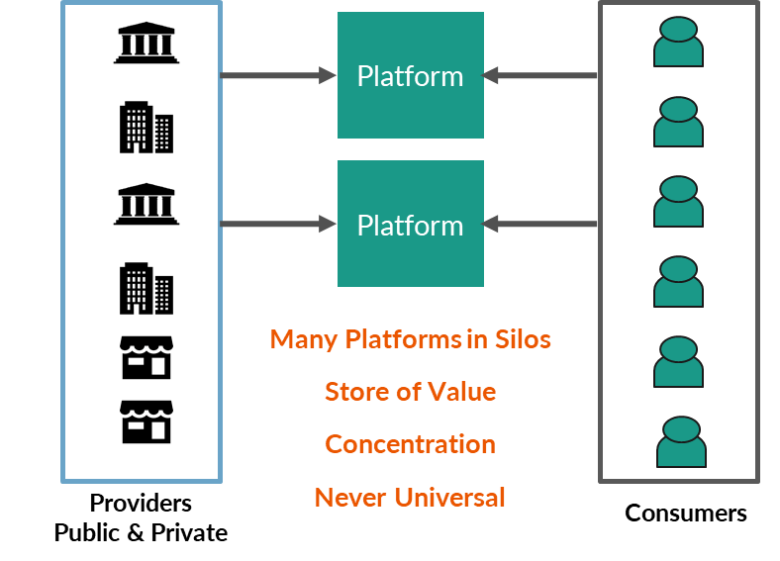
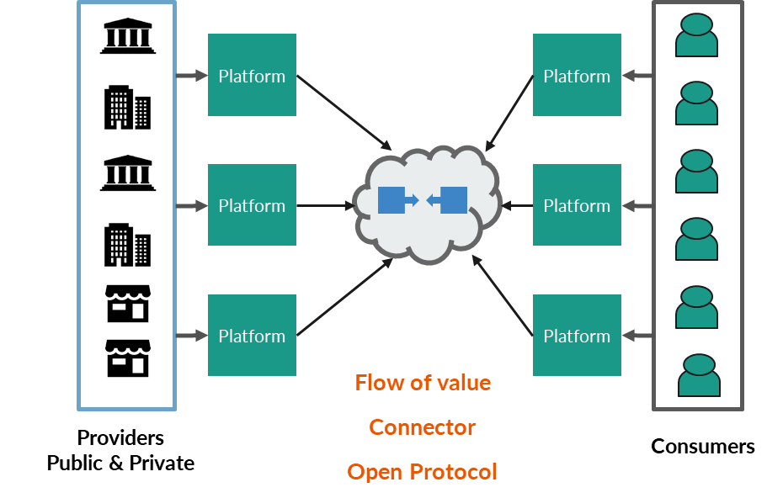
Platform to Open Network enables any buyer to transact with any seller
Each Buyer and Seller needs to register only once
Discoverable by the entire ONDC universe

Slide 8
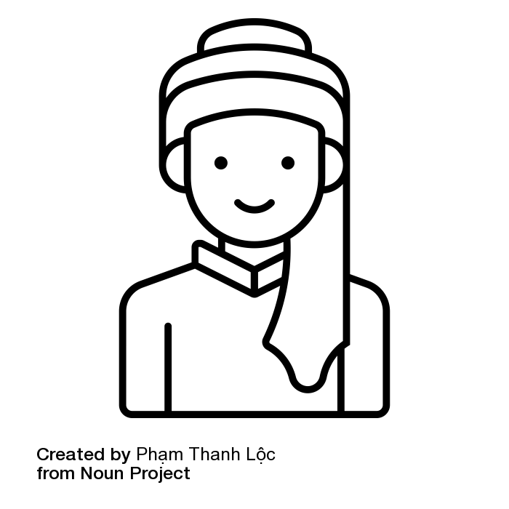
Unbundled, interoperable Commerce - buying journey of Vijay the ONDC way*
Vijay logs onto a Consumer Application and searches for options to buy Atta
The gateways will check the multi-domain registry and broadcast search to retailer seller nodes
1
Buyer Node
Consumer application
ONDC Network
The following search results are displayed to Vijay to choose from:
Gupta Kirana Store– INR 50 (without delivery)
BigBasket (fulfilled by Modern Kirana Store) – INR 150 (with Delivery)
VPA
Gateway
(multiple)
Multi-domain Network registry
Vijay places order for Atta through Gupta Kirana Store (without delivery)
Vijay searches for delivery services
2
The gateway will check the multi-domain registry and broadcast search to delivery seller nodes
Big Basket
Vijay is informed that Dunzo will deliver from Gupta Kirana Store at INR 50 and Goodbox at INR 70 in his Pincode.
Seller Node (Logistic)
Seller Node (Retail)
Seller Node (Retail)
Vijay selects Dunzo for delivery.
Modern Kirana Store
Vijay is told through consumer app that he can make payment through UPI or COD
Supermarket
3
Gupta Kirana Store
Vijay makes payment of INR 50 through UPI via VPA for Atta from Gupta Kirana Store & INR 50 for delivery via Dunzo.
*All logos are used for illustrative purposes only

Slide 9
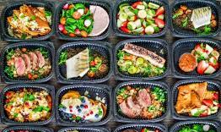
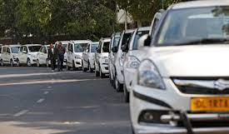
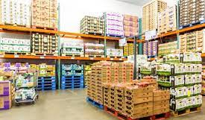
A network with potential to democratize multiple domains across sectors
Tourism & Hospitality
Travel
Food Delivery
Mobility
Wholesale
and many more..

Slide 10
c
For all participants, ONDC brings benefits not possible before
FOR SELLERS
FOR BUYERS
FOR TECHNOLOGY COMPANIES
Discoverable by entire buyer universe
Maintain one-time, single registration
Low cost access to complete value chain
Autonomy on rules & terms
Increased profitability
Business enhancement analytics
Portable network-wide reputation
No disintermediation risk
Single platform accesses all domains
Access all sellers in each domain
Unified experience
Wider options for price, delivery, add-ons
Faster hyper-local fulfilment
Buyer experience key differentiator
Maximise value of your technology
Innovate to your strengths
Monetisation opportunity on transactions
Less time-to-scale
Enhanced platform loyalty
10

Slide 11
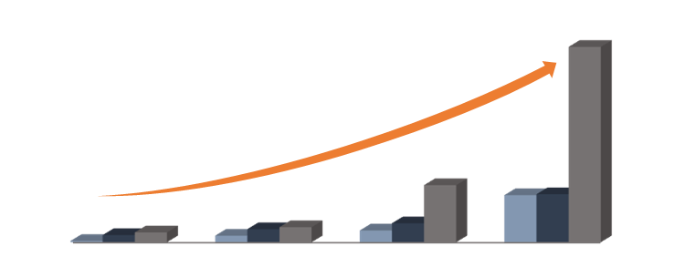
ONDC is live with sellers in 40+ cities
No. of cities live
44,821
No. of sellers live
No. of SKUs live
Meerut
Bijnor
Faridabad
4
2
Chandausi
Gangtok
1
1
Moradabad
13,095
147
28
1
1
36
Delhi
Kanpur
40
3,453
9
58
2
7
1
5
Shillong
1
22
2,259
5
Jaipur
Lucknow
1
1
Bareli (MP)
April’22
May’22
June’22
July’22
Indore
1
Bhopal
1
1
Kolkata
Chhindwara
1
Cuttack
36 Cities and 147 Sellers taken live in 3 months
Pune
2
Mumbai
5
Grocery and F&B Categories with Hyperlocal Fulfilment
Kaup
1
Chikmagalur
Bengaluru
Udupi
2
42
1
Chittoor
Mangalore
4
4
1
Thiruvallur
Coimbatore
1 Retail Buyer NP
5 Retail Seller NPs
1 Logistics Seller NPs
Surathkal
5
4
Chennai
Kannur
1
10
1
Kancheepuram
Thrissur
1
Mannar
1
1
Ramanathapuram
1
Ernakulam
Theni
No. of sellers
1

Slide 12
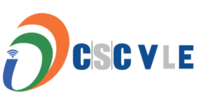
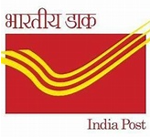
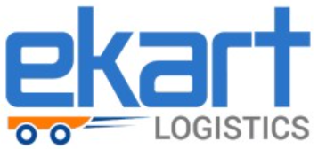
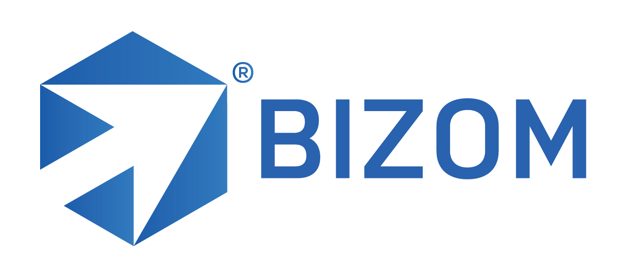
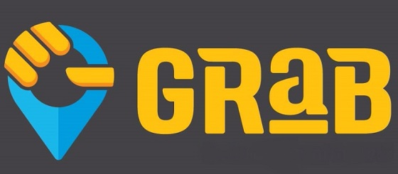
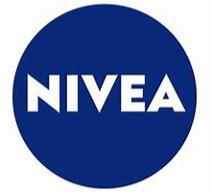
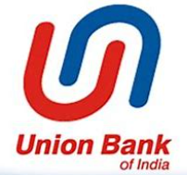
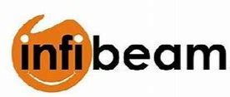
Current visibility of Network Participants
Seller-side Applications
Buyer-side Applications
Logistics Applications
Live Participants
9
Final Stages of Integration
20+
Initial Connects
200+
And more…
And more…
And more…
12

Slide 13
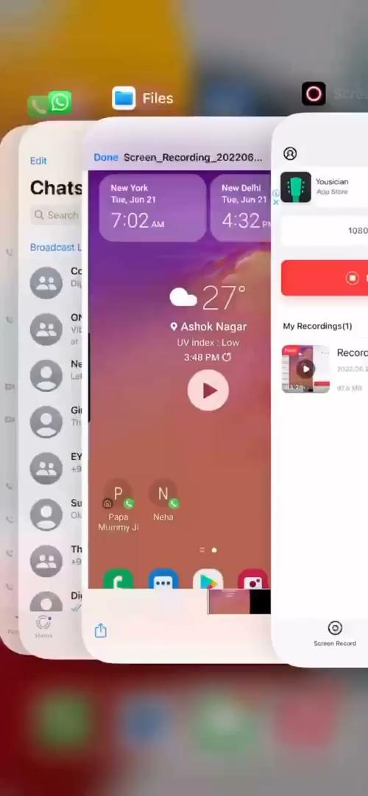
Let’s understand buying journey on ONDC*
*All logos are used for illustrative purposes only
Notes:
Now, we will like to take you through the ONDC journey through a demo of a transaction on the network. In this, we demonstrate interaction among three ONDC enabled applications PhonePe, SellerApp and Loadshare.

Slide 14
Q&A

